Slide 1
Introduction to Shiny

Slide 2
What is Shiny?
R package that lets you build interactive web apps using R code
Based on a reactive programming model (similar to how cells in a spreadsheet update)
It’s powerful because you can use it to quickly turn analyses and visualizations into interactive web apps without writing any HTML, CSS, or JavaScript (and easily deploy them for free)

Slide 3
What is it used for?
Analytics Dashboards: Soccer Analytics
Tools/Widgets: College Explorer
Cool Stuff: Cocktail Optimizer
And more!
Reading, writing, and managing databases
Making a simple chat room
Widgets for education/teaching
Making it easier for your co-authors to see the results of a paper
Here’s a link to a Shiny app created by Avi Stein (Wes ‘17) that shows all of Wesleyan’s senior housing options!

Slide 4
Basic Structure
There are a few ways to write Shiny apps (shinydashboard, RMarkdown, etc)
An app lives in a single R script called app.r (that’s the convention, but it can be called anything you want I think)
Within that script, you define a ui and a server
ui is where you specify how the app should look (plots, user input/buttons)
server is where you specify functions to build the plots and handle user input

Slide 5
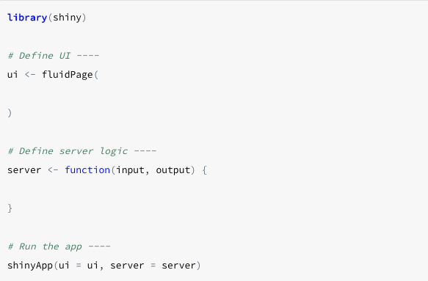
http://shiny.rstudio.com/images/shiny-cheatsheet.pdf

Slide 6
Reactivity
Users interact with a Shiny app by toggling widgets (buttons, dropdown menus, check boxes, plots, etc)
You can bring Shiny apps to life by using reactive expressions, which use widget input and return values
A reactive expression automatically updates whenever a widget that it uses (i.e. appears in the body of the expression) is updated

Slide 7
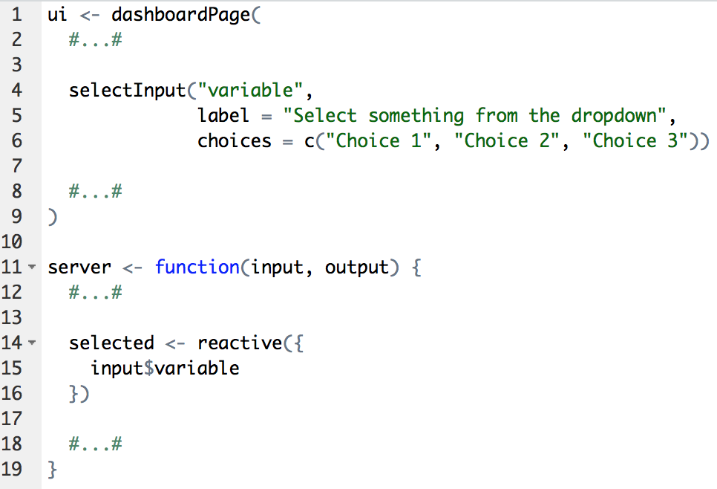

Slide 8
Deploying
Before deploying an app, you can easily view and test on your local machine straight from RStudio
Deploying on the cloud: Shinyapps.io (no hardware or installation, and there are free options)
Deploying on premises: Shiny Server (requires server space)

Slide 9
Reactive Example Demo
Fairness App Demo

